Slide 1
C213 Calculations Cohort
Harold Lagroue, Ph.D., CPA

Slide 2
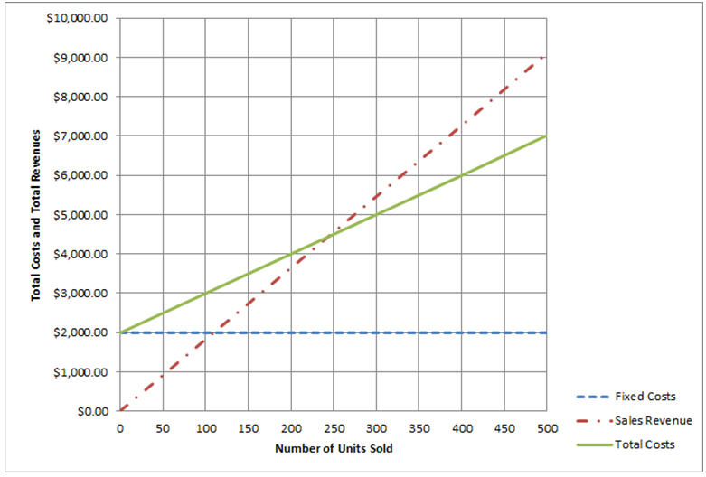
Cost-Volume-Profit Analysis
Which statement is true with respect to the point on this graph when sales are at 300 units per month?
Notes:
Fixed costs are $2,000; Revenues are $5,500; Total Costs are $5,000

Slide 3

Cost-Volume-Profit Analysis
What do total costs equal at the break-even point?
How do total costs and “cost per unit” change as volume changes?
Notes:
$4,500 (where total costs equal total revenues)

Slide 4
Break-Even Analysis
You own a hamburger business with the following costs: • Each hamburger has a selling price of $5 • The variable cost per hamburger (patty, bun, lettuce and tomato, mayonnaise and mustard) is $3 • Total fixed costs per month (rent, utilities, insurance, are $1,000
What is the contribution margin?
How many hamburgers do you need to sell each month to break even?
What do you need in dollar sales to break-even”?
How many hamburgers need to be sold to make $2,000 per month profit?
Notes:
Contribution margin= $5 minus $3 = $2 Breakeven Units = Fixed Costs / Contribution Margin = $1,000 / $2 = 500 Dollar sales Break-Even = Breakeven Units x Selling price per Unit = 500 x $5 = $2,500 Target Profit Units = (Target Profit + Fixed Costs) / Contribution Margin = $3,000 / 2 = 1,500

Slide 5
Incremental Profit
A company reported the following information for the production and sale of 100,000 gallons of oil: Sales $1,000,000
Variable Costs $750,000
Gross Profit $250,000
What would be the gross profit if the company increased its selling price per gallon by $0.50?
Notes:
100,000 x $.50 = $50,000 : $50,000 + $250,000 current gross profit = $300,000 new gross profit

Slide 6
Activity Based Costing
Company A calculated the following information under traditional and activity-based costing for the production and sale of 1,000 units of Product B:
 | Traditional | ABC
Sales | $200,000 | $200,000
Cost of goods sold | $175,000 | $225,000
Gross margin | $25,000 | ($25,000)
Notes:
Acticvity based Costing (the ABC column) gives more accurate information for Cost of Goods Sold. Since they are selling the items for less than its’s actually coting them to make them, they need to go up on the price.

Slide 7
Applied Overhead
Given the following information: What is the amount of applied overhead?
Overhead Rate = Estimated Overhead /Estimated Production
Applied Overhead = Units Produced x Overhead Rate
Estimated Overhead: $500,000 Pairs of shoes expected to be produced | 2,000,000
Pairs of shoes actually produced | 2,400,000
Overhead rate | $0.25
Applied Overhead =
Notes:
Applied Overhead = Units produced x Overhead Rate = 2,400,000 x $.25 = $600,000

Slide 8
Activity Based Costing
A manufacturer produces three products: A, B, and C. The company uses the following information to determine activity rates for each pool:
A manufacturer produces three products: A, B, and C. The company uses the following information to determine activity rates for each pool:
Cost Pool | Costs | Total Activity
Pool 1 | $500,000 | 10,000 hours
Pool 2 | $30,000 | 200 pounds
Pool 3 | $20,000 | 200 moves
Total | $550,000
Data concerning the three products appear below. What is the total overhead applied to Product B
Cost Driver | Products A | Products B | Products C
Number of hours | 10,000 | 9,500 | 2,500
Number of pounds | 150 | 350 | 100
Number of moves | 20 | 90 | 50
Notes:
Three Step Process. Step 1: Calculate “Rates” in first table. (Rate 1 = $500,000 / 10,000 Rate 2 = $30,000 / 200 Rate 3 = $20,000 / 200) Step 2: Multiply each amount in the Product B column by the respective rate (9,500 x Rat 1 , 350 x Rate 2, 90 x Rate 3) Step 3: Add each amount calculated in Step 2

Slide 9
Cost of Goods Sold
During its first month of operations, a manufacturer incurs the following costs related to activities within its factory. What amount should be reported as cost of goods sold on the income statement if 4,000 units are produced and 3,000 are sold?
Direct materials $25,000
Direct labor $35,000
Manufacturing overhead $60,000
Notes:
$120,000 cost divided by 4,000 units produced = $30 Cost per Unit x 3,000 units SOLD = $90,000 Cost of goods Sold

Slide 10
Product Costs
During its first month of operations, a manufacturer incurs the following costs in dollars related to activities within its factory. What are the manufacturer’s total product costs for the month?
Direct materials costs | $5,000
Indirect materials | $2,000
Direct labor | $15,000
Indirect labor | $3,000
Factory rent | $10,000
Depreciation on factory equipment | $8,000
Notes:
Any cost with the word direct , indirect, or factory is a product cost (all are product costs)

Slide 11
Pro Forma Calculations
What was the 2016 net profit amount if the 2017 pro-forma net profit of $157,000 was based on a 15% increase?
Notes:
Divide $157,000 by 1.15 to get the earlier year amount

Slide 12
Transaction Analysis
In January of year 1, the company provided technology-related services worth $20,000. Customers paid a total of $12,000 in cash for these services and promised to pay the remainder the following month. What will be the total impact of these services provided on the company’s balance sheet other than an increase in cash of $12,000?
Notes:
Accounts receivable increases by $8,000 ($20,000 less $12,00 received)

Slide 13
Prepaid Insurance
On July 1, 2018, a company using accrual accounting purchased equipment costing $600,000. It expects the equipment to have a useful life of ten years. At the time of purchase, the company also purchased a one-year insurance policy on this equipment, which cost $12,000. How much insurance expense should the company have recognized for the year ending in 2018?
Notes:
$12,000 policy cost divided by 12 months = $1,000 per month insurance expense x 6 months = $6.000 total insurance expense for year

Slide 14
Advertising Expense
A furniture company using accrual accounting purchased 10 sofas in November 2018. In December 2018, 15 of the 20 sofas were sold to customers. In January 2019, the furniture company paid $4,000 for advertising that ran in the local newspaper in November 2018. In which month should advertising costs be expensed?
Notes:
Advertising expense is recognized in the month the ad runs, regardless of when it is paid for.

Slide 15
Prepaid Insurance
On May 31, a corporation paid $12,000 cash for a one-year insurance policy. The policy period will begin on June 1, year 1. What will be the impact of the May 31 event on the company’s balance sheet on that date?
Notes:
Since none of the insurance has been used as of the end of May, the full $12,000 would be shown as Prepaid insurance on the may 31st Balance Sheet

Slide 16
Transaction Analysis
On April 5, a corporation purchased equipment to be used in the business for $100,000 cash. What will be the impact of the April 5 event on the company’s balance sheet on that date?
Notes:
Equipment will increase by $100,000 and cash will decrease by $100,000

Slide 17
Times Interest Earned
Describe how to calculate the Times Interest Earned Formula.
Notes:
Times Interest Earned = Operating Income divided by Interest Expense (or Cash Income before interest and taxes divided by cash paid for interest, on a cash basis)

Slide 18
Cash Flow Adequacy Ratio
How to determine if a cash flow adequacy ratio* is indicative of a so-called “cash cow”
*Cash flow from operations ÷ (Long-term debt paid + Fixed assets purchased + Cash dividends distributed)
Notes:
If first number (numerator) is bigger than second number (denominator), the fraction would indicate a cash Cow

Slide 19
Debt Ratio
Debt Ratio Formula: Total Liabilities / Total Assets
What does it mean if a company has a debt ratio of 115%?
Notes:
A debt ratio of 115% means that liabilities exceed assets by 15%

Slide 20
Revenue Recognition
Under accrual accounting, Revenue is recognized in the year that services are provided, or when a sale is fully consummated, regardless of whether the money is received in the year before or the year after the sale.
Notes:
Under accrual accounting, Revenue is recognized in the year that services are provided, or when a sale is fully consummated, regardless of whether the money is received in the year before or the year after the sale.

Slide 21
Accounting Equation
A corporation has total liabilities of $400 million, total owners’ equity of $200 million, and current assets of $150 million. What is the value of the firm's long-term assets?
Notes:
Assets = Liabilities + Owners Equity……So Assets = $400 mil + $200 mil or $600 million $600 million in total assets less $150 million of current assets = $450 million of long-term assets

